Slide 1
Authentic Leadership in a Diverse Community
Claire Palo and Kristen Cvancara

Slide 2
Project Content
In a diverse cultural setting, a leader has the dilemma of presenting their authentic self while preventing ethnocentrism.
Ethnocentrism— the belief that one’s own culture and values are superior to another’s—may interfere with a leader’s ability to relate and communicate effectively.

Slide 3
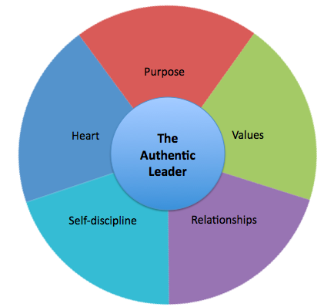
Authentic Leadership & Culture
Culture is defined as learned beliefs, values, rules, norms, symbols, and traditions.
Authentic leaders are governed by a strong set of internal values and morals.
Authenticity emerges from the reciprocal processes between leaders and followers.

Slide 4
Method & Procedures
A case study of a community leader who works with individuals from diverse backgrounds was conducted.
A qualitative semi-structured interview was performed in the leader’s professional environment.
Open-ended questions were asked pertaining to the leader’s personal methods for leadership.
The interview was an hour long and was audio recorded with the consent of the leader.

Slide 5
Results
While results did not directly correspond to ethnocentrism in leadership, the leader expressed concepts that she uses to navigate relationships in her leadership.
  Connection
  Explanation
  Communication
  Respect

Slide 6
Connection
To be able to understand a person’s character and culture, a connection with that individual has to be established.
The leader says that when there is a connection between an individual and her “[They] listened together.”

Slide 7
Explanation
The leader expressed that the act of explanation helps reinforce her authentic self, while also helping to prevent ethnocentrism in others.
As a leader, an issue of race sometimes occurs for the leader, but she explains what some people do not understand.

Slide 8
Communication
The leader’s communication style is specific to individual followers.
She has a strong sense of her own character which allows her to navigate the behaviors of others.
The leader often faces challenges of being judged, because people are unwilling to communicate with her.
One simple way that helps the leader avoid ethnocentrism is for her to talk with individuals.

Slide 9
Respect
The value that guides her leadership is respect.
Respect is a large part of her culture.
Although she says that she often disagrees with her followers she says, “it doesn’t matter, I want to respect what [they] are.”
“One thing I learn from people is the more you respect them the more they respect you.”

Slide 10
Discussion
In a world consisting of diverse people, understanding how to remain authentic and avoid ethnocentrism is indispensable.
Race |  | % of Total
Total Population | 100%
White | 89%
Black or African American | 4%
Hispanic or Latino | 2%
Asian | 2%
Two or More Races | 2%
Some Other Race | Below 1%
American Indian | Below 1%

Slide 11
Discussion
An implication of the research is that students in leadership roles, who work with people from various backgrounds, can gain strategies for communication and presenting the authentic self.
MNSU has a wonderful international program with 1,129 enrolled students from 89 countries.

Slide 12
Discussion
The case study revealed some concepts of how one leader communicates with individuals and how she is sensitive to the personal experiences and backgrounds of these individuals.
A case study is limited in that it studies only one individual’s way of leadership and communication.
Future studies might consist of more case studies, focusing on leaders who have different cultures and therefore different communication styles.

Slide 13
Conclusion
“When you talk with people, you can change their lives and in return they can change yours.”

